Slide 1
CSC-257 Theory Of Computation (BSc CSIT, TU)
Ganesh Khatri
kh6ganesh@gmail.com

Slide 2
Derivation Tree / Parse Tree
Parse tree is a tree representation of strings of terminals using the productions defined by the grammar.
It is pictorial representation of derivation of a string defined by a grammar.
A parse tree pictorially shows how the start symbol of a grammar derives a string in the language
Parse tree may be viewed as a graphical representation for a derivation that filters out the choice regarding the replacement order

Slide 3
Derivation Tree / Parse Tree
Formally, given a Context Free Grammar G = (V, T, P, S), a parse tree is a tree having following properties :
The root is labeled by the start symbol
Each interior node of parse tree are variables(Non Terminals)
Each leaf node of parse is labeled by a terminal symbol or ε
If an interior node is labeled with a non terminal A and its childrens are x₁, x₂ …………….x_{n} from left to right then there is a production P as : A → x₁, x₂, ……………….x_{n} for each x_{i} Є T

Slide 4
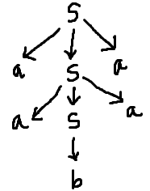
Derivation Tree / Parse Tree
Consider a grammar S → aSa | a | b | ε
Now for string S →* aabaa, we have
S → aSa
S → aaSaa
S → aabaa
And the parse tree is :

Slide 5
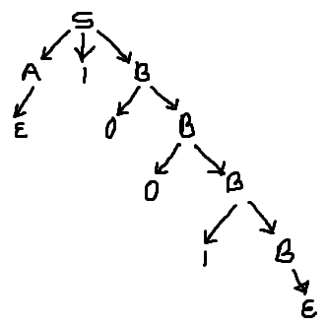
Derivation Tree / Parse Tree
Exercise : 1
Consider the Grammar G :
S → A1B
A → 0A | ε
B → 0B | 1B | ε
a) Construct the parse tree for 00101
b) Construct the parse tree for 1001
c) Construct the parse tree for 00011
Note : Construct parse trees for both leftmost as well as for rightmost derivation
Parse tree for 1001 : leftmost derivation
Notes:
Parse tree for 1001

Slide 6
Derivation Tree / Parse Tree
Exercise : 2
Consider a CFG G :
S → S + S
S → S * S
S → S
S → a
And the string to be derived is "a+a*a”
Construct the parse trees for leftmost and rightmost derivation of string and derivations are given as
S → S + S
S → a + S
S → a + S * S
S → a + a * S
S → a + a * a
S → S * S
S → S * a
S → S + S * a
S → S + a * a
S → a + a * a
leftmost derivation
rightmost derivation
Notes:
leftmost derivation

